Slide 1
Undercover Martyn
CMS

Slide 2
Team Description
Notes:
RRM

Slide 3
Reece Schenck
I am a computer science and cybersecurity major and I am the manager of the club volleyball team here at Marist. I chose to work with my other team members as they seem very hard working, intelligent, and enthusiastic about this project.
Roman Huerta Manrique
I obtained my Bachelor's degree in Informatics Engineering from the Pontifical Catholic University of Peru and began my professional career as a Web Developer Analyst at the same institution, where I worked as a Full-Stack Developer. Subsequently, I transitioned into the field of education, serving as a Mathematics instructor for two years as part of the TeachForPeru program. Most recently, I worked as a Content Creator at Crack The Code, a coding school based in Latin America. I am proficient in PHP, HTML, JavaScript, Python, Java, and SQL. Currently, I am pursuing a Master of Science in Computer Science at Marist University, with a concentration in Artificial Intelligence.
Michelle Macina
I completed a Bachelor of Arts in International Studies at Elon University and am now looking to obtain a Master of Science in Computer Science at Marist University.

Slide 4
Outline
Notes:
M

Slide 5
Objective: To manage contact information for multiple users.
(i.e. cell number, home number, fax number, address)
Key Features:
Add a user.
Remove a user.
Edit the contact records.
Search through contacts.

Slide 6
System Description
Notes:
Michelle

Slide 7
What makes it a good solution for managing contact information?
Scalability:
Design supports individual and larger use.
Ability for growth.
Reliability:
Fast , secure, organized.
Security:
Role based login with mandatory admin credentials.
Secure, Organized, Efficient.

Slide 8
What features does it offer?
Add, edit, and remove detailed contacts.
Store and manage: cell numbers, email addresses, fax numbers, home numbers, and physical addresses.
Admins can manage user accounts (adding or removing users and assigning credentials).
Normal users are restricted to contact management tasks.
Search filters enables users to quickly locate specific users based on identifies features (phone number, name).
User friendliness with a welcoming interface, menu driven navigation, and tabular reports.
Error handling mechanisms.

Slide 9
Overview & Advantage
All in one solution.
Outperforms tools like HubSpot, Pipedrive, and Insightly in customization and functionality.
Adaptability for different users and organizations.

Slide 10
Entity Relationship Model
Notes:
Reece

Slide 11
External Models
External Model 1: User and Activities
Focused on the relationship between users, their login credentials, and their relations to meetings and activity logs.
Entities:
User: Represents the individuals who use the CMS.
Meeting: Stores details of meetings.
ActivityLog: Tracks user activities.
ActivityType: Categorizes logged activities.
Relationships:
A User can perform many ActivityLogs (1:N).
A User can organize many Meetings (1:N).
An ActivityLog is an ActivityType (1:N).
External Model 2: Contacts and Contact Management
focused on the relationship between contacts and all of their elements.
Entities:
Contact: Stores contact details.
Tag: Labels assigned to contacts.
Group: Groups contacts for better organization.
Company: Companies that contacts are associated with.
ContactNote: Notes related to a contact.
Email: Stores email addresses.
Picture: Stores profile image.
Phone: Stores phone numbers and types.
Relationships:
A Contact can have many Phones (1:N).
A Contact can have many Emails (1:N).
A Contact has only one profile Picture (1:N).
A Contact can have numerous ContactNotes (1:N).
Multiple Contacts can have a Company (1:N).
Multiple Contacts can belong to multiple Groups (M:N).
Multiple Contacts can have multiple Tags (M:N).

Slide 12
External Model 1 Diagram
Notes:
Reece

Slide 13
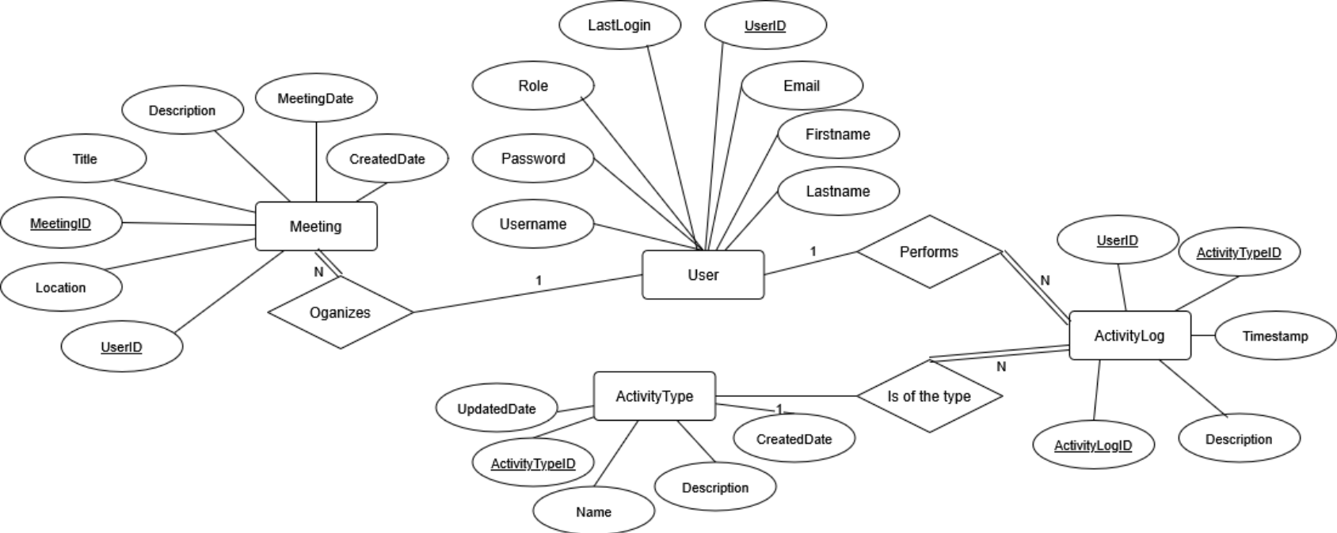

Slide 14
External Model 2 Diagram
Notes:
Reece

Slide 15
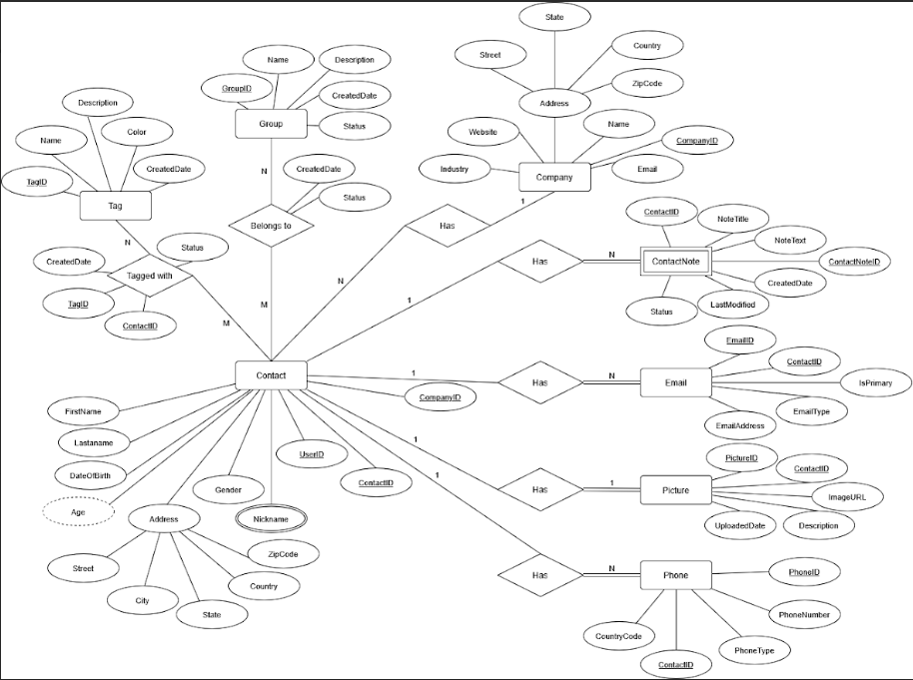

Slide 16
Conceptual Model
Entities and Attributes
User:
Attributes: UserID, Username, Password, Email, Role, FirstName, LastName, LastLogin.
Contact:
Attributes: ContactID, UserID, CompanyID, FirstName, LastName, DateOfBirth, Gender, Nickname, Address, Age.
Phone:
Attributes: PhoneID, ContactID, PhoneNumber, PhoneType, CountryCode.
Email:
Attributes: EmailID, ContactID, EmailAddress, EmailType, IsPrimary.
Picture:
Attributes: PictureID, ContactID, ImageURL, UploadedDate, Description.
ActivityLog:
Attributes: ActivityLogID, UserID, ActivityTypeID, Timestamp, Description.
ActivityType:
Attributes: ActivityTypeID, Name, Description, UpdatedDate, CreatedDate.
ContactNote:
Attributes: NoteID, ContactID, NoteTitle, NoteText, CreatedDate, LastModified, Status.
Group:
Attributes: GroupID, Name, Description, CreatedDate, Status.
Tag:
Attributes: TagID, Name, Description, CreatedDate, Color.
Meeting:
Attributes: MeetingID, Title, Description, Location, Time, CreatedDate.
Company:
Attributes: CompanyID, Name, Industry, Address, Email, Website.

Slide 17
ER Diagram
Notes:
Reece

Slide 18
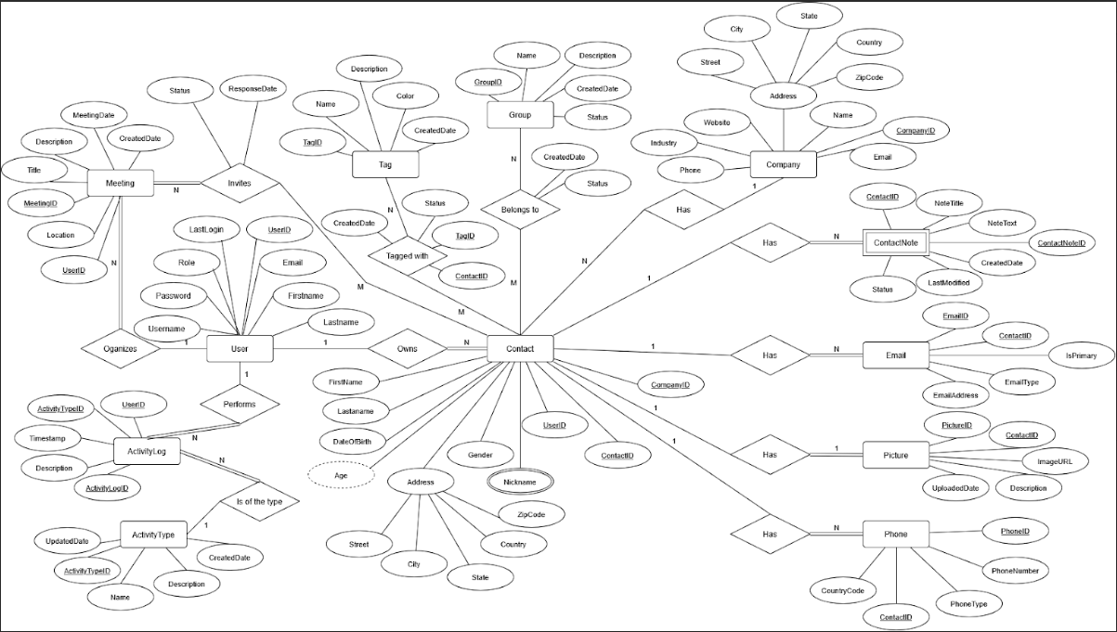

Slide 19
Enhanced Entity Relationship Models
Each entity, such as User, Contact, and Phone, was designed with at least five attributes, including a primary key (PK) to ensure unique identification of records.
UserID in the User entity and ContactID in the Contact entity serve as primary keys.
Foreign Keys (FK) were introduced to establish relationships between entities, such as the UserID in the Contact entity, which references the UserID in the User entity.
1:1, 1:N, and M:N cardinalities:
1:1 relationship, such as between Contact and Picture, ensures that each contact may have only one picture.
1:N relationship, such as between User and Contact, allows each user to have multiple contacts.
M:N relationship, such as between Contact and Tag, enables many-to-many interactions where a contact may have zero or many tags, and a tag may be related to one or more contacts.
Total participation was applied where every instance of an entity must participate in a relationship, such as every Contact requiring at least one Phone.
Partial participation was used where relationships are optional, such as not all Contacts having a Company.
Multivalued, composite, and derived attributes:
Nickname attribute in the Contact entity supports multiple values.
Address attribute was designed as a composite attribute, breaking down into Street, City, State, ZipCode, and Country.
Age attribute in the Contact entity, was derived based on the DateOfBirth attribute.

Slide 20
EER Diagram
Notes:
Reece

Slide 21
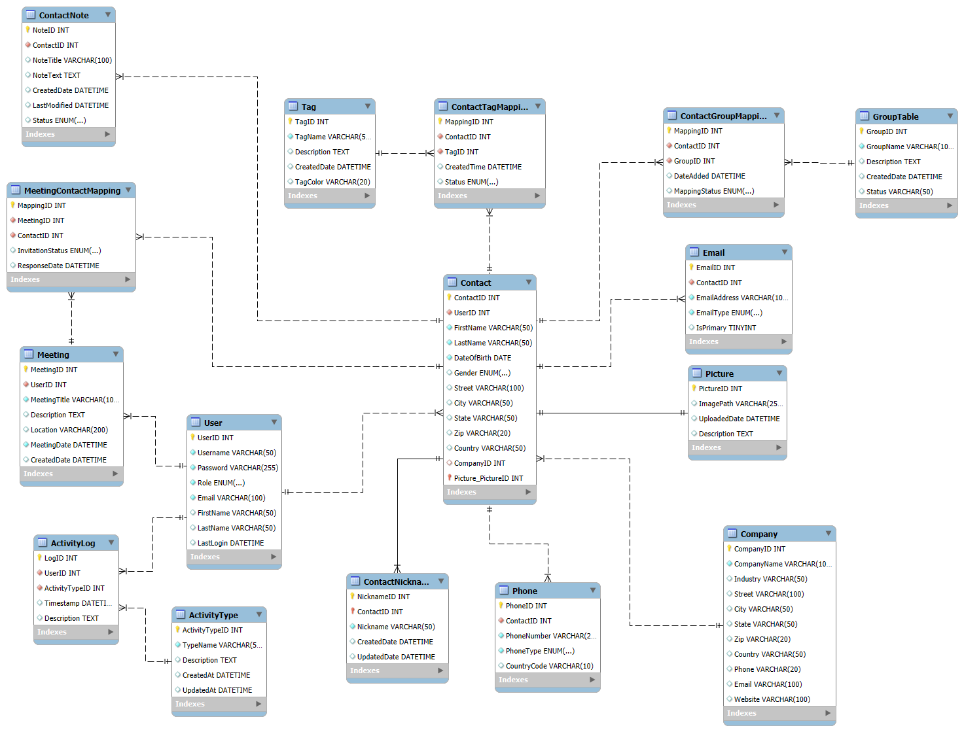

Slide 22
Database Development
Notes:
M

Slide 23
Database Development
Create Schema:
Where all the tables will be created in, the character set says what set of characters will be used, in this case the UTF8 character encoding will be used, this has more support for non-English characters.
Table Creation:
It defines the structure of the table by specifying each column’s data type, whether it can be null, and its default value. It also sets a primary key to uniquely identify each contact, creates foreign key relationships, and defines indexes.

Slide 24
User Table
Description: Stores information about system users, including their login credentials, personal details, and role within the system.
Attribute | Data Type | Key | Description
UserID | INT AUTO_INCREMENT | PK | Unique identifier for each user.
Username | VARCHAR(50) NOT NULL UNIQUE |  | Stores the user's login username, which must be unique.
Password | CHAR(64) NOT NULL |  | Securely stores hashed user passwords using a robust encryption mechanism.
Role | ENUM('ADMIN', 'NORMAL') NOT NULL |  | Defines user roles and their access levels.
Email | VARCHAR(100) NOT NULL UNIQUE |  | Stores user email, ensuring uniqueness.
FirstName | VARCHAR(50) NULL |  | First name of the user.
LastName | VARCHAR(50) NULL |  | Last name of the user.
LastLogin | DATETIME NULL |  | Stores the last login timestamp of the user to track activity.

Slide 25
Company Table
Description: Holds details about organizations that interact with the system. It is referenced by the Contact Table to associate a contact with a company.
Attribute | Data Type | Key | Description
CompanyID | INT AUTO_INCREMENT | PK | Unique identifier for each company.
CompanyName | VARCHAR(100) NOT NULL UNIQUE |  | Stores the company name, ensuring uniqueness.
Industry | VARCHAR(50) NULL |  | Represents the industry in which the company operates.
Street | VARCHAR(100) NULL |  | The street address of the company.
City | VARCHAR(50) NULL |  | The city where the company is located.
State | VARCHAR(50) NULL |  | The state where the company is located.
Zip | VARCHAR(20) NULL |  | Zip code of the company's address.
Country | VARCHAR(50) NULL |  | Country where the company operates.
Phone | VARCHAR(20) NULL |  | Contact phone number of the company.
Email | VARCHAR(100) NULL |  | The company's official email.
Website | VARCHAR(100) NULL |  | The company's website URL.
Notes:
Here Contact have to be capitalized and also table, and the first word after the semi-colon doesn’t have to be capitalized

Slide 26
Picture Table
Description: Used to store metadata about images uploaded to the system. The Contact Table references it to associate a contact with a profile picture.
Attribute | Data Type | Key | Description
PictureID | INT AUTO_INCREMENT | PK | Unique identifier for each picture.
ContactID | INT | FK | Foreign key referencing Contact(ContactID).
ImagePath | VARCHAR(255) NULL |  | Stores the file path of the image.
UploadedDate | DATETIME DEFAULT CURRENT_TIMESTAMP |  | Records the timestamp of when the image was uploaded.
Description | TEXT NULL |  | Provides additional details about the image.

Slide 27
Contact Table
Description: Stores personal and professional details about individuals who are associated with companies or users.
Attribute | Data Type | Key | Description
ContactID | INT AUTO_INCREMENT | PK | Unique identifier for each contact.
UserID | INT NOT NULL | FK | Foreign key referencing User(UserID).
FirstName | VARCHAR(50) NOT NULL |  | Contact's first name.
LastName | VARCHAR(50) NOT NULL |  | Contact's last name.
DateOfBirth | DATE NOT NULL |  | Contact's date of birth.
Gender | ENUM('M', 'F', 'Other') NULL |  | Contact's gender.
Street | VARCHAR(100) NULL |  | Contact's street address.
City | VARCHAR(50) NULL |  | Contact's city.
State | VARCHAR(50) NULL |  | Contact's state.
Zip | VARCHAR(20) NULL |  | Contact's zip code.
Country | VARCHAR(50) NULL |  | Contact's country.
CompanyID | INT NULL | FK | Foreign key referencing Company(CompanyID).

Slide 28
ContactNickname Table
Description: Stores alternative names used for contacts. This allows flexibility in managing different names a contact might be known by.
Attribute | Data Type | Key | Description
ContactID | INT NOT NULL | PK | Primary key referencing Contact(ContactID).
Nickname | VARCHAR(50) NOT NULL | PK | The alternative name for the contact.

Slide 29
Phone Table
Description: Stores phone numbers associated with contacts, allowing multiple phone numbers for each contact.
Attribute | Data Type | Key | Description
PhoneID | INT AUTO_INCREMENT | PK | Unique identifier for each phone number.
ContactID | INT NOT NULL | FK | Foreign key referencing Contact(ContactID).
PhoneNumber | VARCHAR(20) NOT NULL |  | The actual phone number.
PhoneType | ENUM('Cell', 'Home', 'Work', 'Fax') NOT NULL |  | Specifies the type of phone number.
CountryCode | VARCHAR(10) NULL |  | Stores the country code of the phone number.

Slide 30
Email Table
Description: Stores email addresses associated with contacts, allowing multiple email addresses per contact.
Attribute | Data Type | Key | Description
EmailID | INT AUTO_INCREMENT | PK | Unique identifier for each email address.
ContactID | INT NOT NULL | FK | Foreign key referencing Contact(ContactID).
EmailAddress | VARCHAR(100) NOT NULL |  | The email address of the contact.
EmailType | ENUM('Personal', 'Work', 'Other') NOT NULL |  | Specifies the type of email address.
IsPrimary | TINYINT NULL DEFAULT FALSE |  | Indicates if this is the primary email for the contact.

Slide 31
ActivityType Table
Description: Defines different types of activities that can be logged in the system, such as login attempts, updates, deletions, and other user actions.
Attribute | Data Type | Key | Description
ActivityTypeID | INT AUTO_INCREMENT | PK | Unique identifier for each activity type.
TypeName | VARCHAR(50) NOT NULL |  | The name of the activity type.
Description | TEXT NULL |  | A more detailed description of the activity type.
CreatedDate | DATETIME DEFAULT CURRENT_TIMESTAMP |  | Timestamp when the activity type was added.
UpdatedDate | DATETIME DEFAULT CURRENT_TIMESTAMP ON UPDATE CURRENT_TIMESTAMP |  | Timestamp when the activity type was last updated.

Slide 32
ActivityLog Table
Description: Records system activities performed by users, such as logins, updates, and data modifications. It helps in tracking user interactions with the system for auditing purposes.
Attribute | Data Type | Key | Description
LogID | INT AUTO_INCREMENT | PK | Unique identifier for each log entry.
UserID | INT NOT NULL | FK | Foreign key referencing User(UserID).
ActivityTypeID | INT NOT NULL | FK | Foreign key referencing ActivityType(ActivityTypeID).
Timestamp | DATETIME DEFAULT CURRENT_TIMESTAMP |  | The time when the activity was logged.
Description | TEXT NULL |  | Additional details about the logged activity.

Slide 33
ContactNote Table
Description: Stores notes associated with contacts, allowing users to maintain additional details or remarks about a contact.
Attribute | Data Type | Key | Description
NoteID | INT AUTO_INCREMENT | PK | Unique identifier for each note.
ContactID | INT NOT NULL | FK | Foreign key referencing Contact(ContactID).
NoteTitle | VARCHAR(100) NULL |  | A title or short description for the note.
NoteText | TEXT NULL |  | The actual content of the note.
CreatedDate | DATETIME DEFAULT CURRENT_TIMESTAMP |  | Timestamp when the note was created.
LastModified | DATETIME DEFAULT CURRENT_TIMESTAMP ON UPDATE CURRENT_TIMESTAMP |  | Timestamp of the last modification to the note.
Status | ENUM('ACTIVE', 'REMOVED') DEFAULT 'ACTIVE' |  | The status of the note.

Slide 34
Group Table
Description: Stores groups that contacts can belong to. These groups help in organizing and categorizing contacts efficiently.
Attribute | Data Type | Key | Description
GroupID | INT AUTO_INCREMENT | PK | Unique identifier for each group.
GroupName | VARCHAR(100) NOT NULL UNIQUE |  | The name of the group.
Description | TEXT NULL |  | Additional information about the group.
CreatedDate | DATETIME DEFAULT CURRENT_TIMESTAMP |  | Timestamp when the group was created.
Status | VARCHAR(50) NULL |  | Status of the group (e.g., active, archived).

Slide 35
ContactGroupMapping Table
Description: Manages the many-to-many relationship between contacts and groups, allowing a contact to belong to multiple groups and a group to contain multiple contacts.
Attribute | Data Type | Key | Description
MappingID | INT AUTO_INCREMENT | PK | Unique identifier for each mapping entry.
ContactID | INT NOT NULL | FK | Foreign key referencing Contact(ContactID).
GroupID | INT NOT NULL | FK | Foreign key referencing Group(GroupID).
DateAdded | DATETIME DEFAULT CURRENT_TIMESTAMP |  | Timestamp when the contact was added to the group.
MappingStatus | ENUM('ACTIVE', 'INACTIVE') DEFAULT 'ACTIVE' |  | Status of the mapping.

Slide 36
Tag Table
Description: Stores different tags that can be assigned to contacts. Tags help in categorizing contacts for easy filtering and identification.
Attribute | Data Type | Key | Description
TagID | INT AUTO_INCREMENT | PK | Unique identifier for each tag.
TagName | VARCHAR(50) NOT NULL UNIQUE |  | The name of the tag.
Description | TEXT NULL |  | Additional details about the tag.
CreatedDate | DATETIME DEFAULT CURRENT_TIMESTAMP |  | Timestamp when the tag was created.
TagColor | VARCHAR(20) NULL |  | Optional color assigned to the tag.

Slide 37
ContactTagMapping Table
Description: Manages the many-to-many relationship between contacts and tags, allowing a contact to have multiple tags and a tag to be associated with multiple contacts.
Attribute | Data Type | Key | Description
MappingID | INT AUTO_INCREMENT | PK | Unique identifier for each mapping entry.
ContactID | INT NOT NULL | FK | Foreign key referencing Contact(ContactID).
TagID | INT NOT NULL | FK | Foreign key referencing Tag(TagID).
CreatedTime | DATETIME DEFAULT CURRENT_TIMESTAMP |  | Timestamp when the tag was assigned to the contact.
Status | ENUM('ACTIVE', 'REMOVED') DEFAULT 'ACTIVE' |  | Status of the tag assignment.

Slide 38
Meeting Table
Description: Stores details about meetings involving users and contacts. It helps in managing scheduled events, discussions, and appointments.
Attribute | Data Type | Key | Description
MeetingID | INT AUTO_INCREMENT | PK | Unique identifier for each meeting.
UserID | INT NOT NULL | FK | Foreign key referencing User(UserID).
MeetingTitle | VARCHAR(100) NOT NULL |  | Title of the meeting.
Description | TEXT NULL |  | Additional details about the meeting.
Location | VARCHAR(200) NULL |  | The location where the meeting is held.
MeetingDate | DATETIME NOT NULL |  | Scheduled date and time for the meeting.
CreatedDate | DATETIME DEFAULT CURRENT_TIMESTAMP |  | Timestamp when the meeting was created.

Slide 39
MeetingContactMapping Table
Description: Manages the many-to-many relationship between meetings and contacts, allowing multiple contacts to participate in a single meeting.
Attribute | Data Type | Key | Description
MappingID | INT AUTO_INCREMENT | PK | Unique identifier for each mapping entry.
MeetingID | INT NOT NULL | FK | Foreign key referencing Meeting(MeetingID).
ContactID | INT NOT NULL | FK | Foreign key referencing Contact(ContactID).
InvitationStatus | ENUM('Accepted', 'Declined', 'Pending') DEFAULT 'Pending' |  | The status of the meeting invitation for the contact.
ResponseDate | DATETIME NULL |  | The date the contact responded to the invitation.

Slide 40
Loading Data
Notes:
M

Slide 41
Importing Data
Using the format
Insert Into “table name” (attributes) (i.e. User, Company, Contact).
Values((corresponding to attributes)).
Example below.
This allows for large amounts of data to be added to the CMS.
INSERT INTO `MyCMS`.`Email` (`ContactID`, `EmailAddress`, `EmailType`, `IsPrimary`) VALUES (1, 'contact1@example.com', 'Personal', 1),

Slide 42
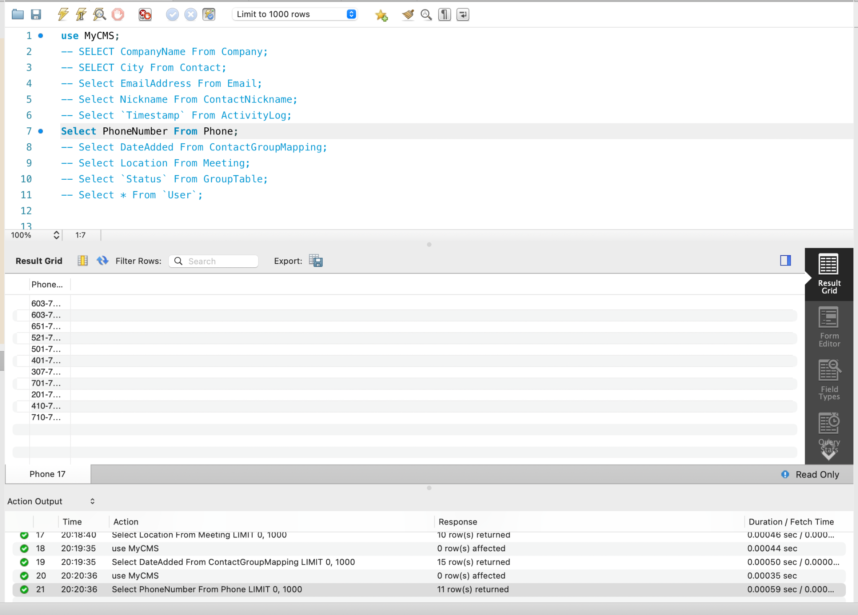
Retrieving Data
Using the format:
Select Attribute from “Table”.
Allows for us to view specific data added to a specified table.
Example —>
This allows for us to quickly view a specific column of information.

Slide 43
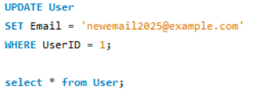
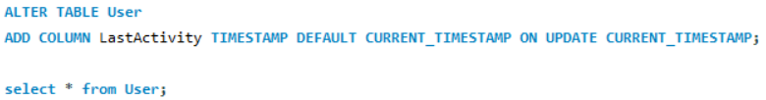
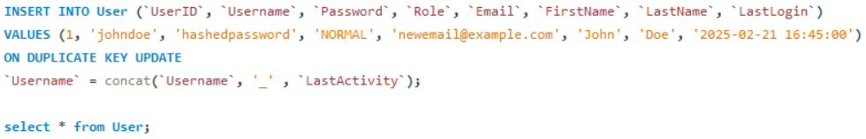
Manipulating Data
Allows for you to update information in the table.
Allows for you to alter the data by adding new attributes.
Allows for non-duplicate info to be changed.
This shows the User email being updated.
This shows a new attribute (LastActivity) being added to the User table.
This shows that if a duplicate user is being added it will update the username to (Username_LastActivity).

Slide 44
Performance Enhancements
Notes:
Michelle

Slide 45


Database Optimization
Inserting instances one at a time completion time:
Inserting multiple values using one insert into statement.
Inserting instances all at once completion time:
Inserting values with their own insert into statements.
Inserting all data at once is 0.2277 seconds faster than inserting data online at a time. That makes bulk inserts 76.42% faster than single line inserts.

Slide 46
Normalization Check
1NF:
Each attribute holds a single indivisible value.
(i.e. Phone number & Email have their own columns).
No multi-values.
(single data in each column).
Avoids redundancy, improves data integrity, simplifies, and creates a more scalable platform for storing and retrieving contact information.
3NF:
In 2NF.
No transitive functional dependencies.
No attribute in a table depends on another attribute which in turn depends on the primary key.
Indirect relationship, making the first attribute depend on the primary key.
2NF:
In 1NF.
All new key attributes depend on the Primary Key.
Sets a foundation for further Normalization.

Slide 47
User Interface
Notes:
Reece

Slide 48
User Interface
Start with the login page.
From there access is granted and user or admin privileges are given.
Admins are shown a user list where they can:
Add users.
Edit users.
Remove users.
View user contact lists.
View activity logs.
Users are shown their contact list where they can:
Add contacts.
Edit contacts.
Remove contacts.
Edit their profile page & password.
Add & edit company information.
View and organize meetings.
Notes:
Reece

Slide 49
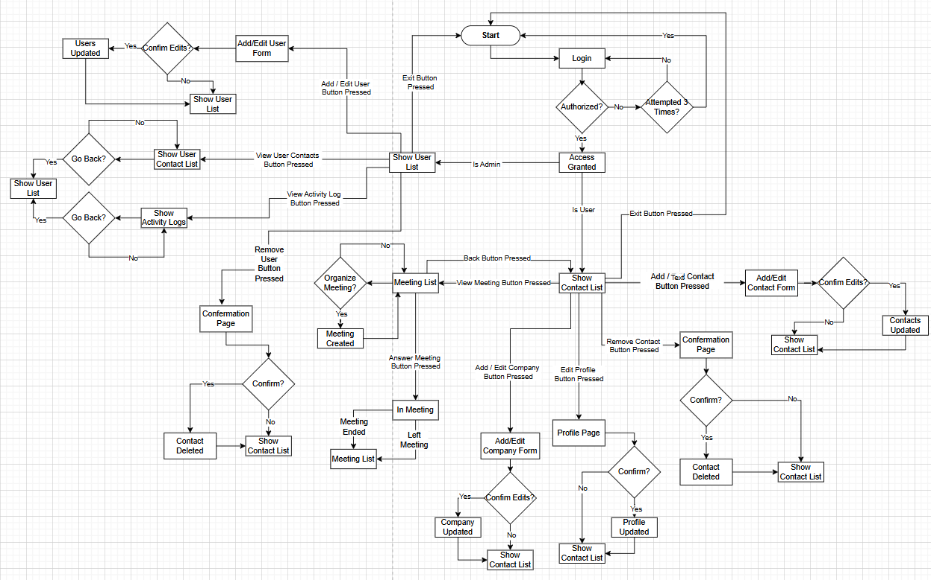
Notes:
Reece

Slide 50
Security Measurements
Notes:
Reece

Slide 51
Access Control
Admin User:
Granted all privileges to all the tables in the database:
Creating a new table.
Reading data from a table.
Adding a new row to a table.
Modifying existing data.
Removing rows.
Deleting a table.
Modifying table structure.
Granting privileges to other users.
Normal User:
For a regular user only viewing, inserting and updating privileges will be assigned:
Reading data from a table.
Adding a new row to a table.
Modifying existing data.
Does Not have:
The bolded on the left.

Slide 52
Inference Control
Create “administrator” role to manage group access.
The role is granted to a user labeled “admin_user”.
Creating a view:
We create a view to know how many contacts the database has and what is the average age of the contacts.
Granting privileges to the view.
Accessing “admin_user” and querying to view.
CREATE ROLE 'administrator';
GRANT 'administrator' TO 'admin_user'@'%';
CREATE OR REPLACE VIEW MyCMS.SummarizedView AS SELECT (SELECT COUNT(*) FROM MyCMS.Contact) AS TotalContacts, (SELECT AVG(TIMESTAMPDIFF(YEAR, DateOfBirth, CURDATE()))
FROM MyCMS.Contact) AS AverageContactAge;
GRANT SELECT ON MyCMS.SummarizedView TO 'administrator';
mysql -u admin_user -padminpassword SELECT * FROM MyCMS.SummarizedView;
Notes:
Commit to semicolon

Slide 53
Flow Control
ALTER TABLE MyCMS.User MODIFY COLUMN Password CHAR(64) NOT NULL;
INSERT INTO MyCMS.User (Username, Password, Role, Email, FirstName, LastName) VALUES ('alice', SHA2('alice_password', 256), 'ADMIN', 'alice@example.com', 'Alice', 'Smith'), ('bob', SHA2('bob_password', 256), 'NORMAL', 'bob@example.com', 'Bob', 'Jones'), ('charlie', SHA2('charlie_password', 256), 'NORMAL', 'charlie@example.com', 'Charlie', 'Brown');
Altering the login table:
Password Field Optimization:
Changed Password column to CHAR(64) for fixed-length SHA-256 hashes.
User Insertion with Hashed Passwords:
Used SHA2(password, 256) to store securely hashed passwords.

Slide 54
Flow Control
DELIMITER // CREATE PROCEDURE MyCMS.AuthenticateUser ( IN inUsername VARCHAR(50), IN inPassword VARCHAR(255) ) BEGIN DECLARE hashedPassword CHAR(64); DECLARE storedPassword CHAR(64) DEFAULT NULL; -- Handler for when no row is found (SQLSTATE '02000') DECLARE CONTINUE HANDLER FOR SQLSTATE '02000' BEGIN SET storedPassword = NULL; END; -- Compute SHA-256 hash of the provided password SET hashedPassword = SHA2(inPassword, 256); -- Attempt to fetch the stored hashed password for the given username SELECT Password INTO storedPassword FROM MyCMS.User WHERE Username = inUsername LIMIT 1;
-- Check if a user exists and if the hashed passwords match IF storedPassword IS NULL THEN SELECT 'Access Rejected: Username not found' AS Message; ELSEIF storedPassword = hashedPassword THEN SELECT 'Access Granted' AS Message; ELSE SELECT 'Access Rejected: Incorrect Password' AS Message; END IF; END // DELIMITER ;
Authentication Procedure (AuthenticateUser):
Inputs: Username, Password.
Hashes input password and compares with stored hash.
Handles missing users and incorrect passwords
Returns either:
Access Granted.
Access Rejected: Incorrect Password / Username not found.

Slide 55
Data Encryption
SET @start_time = SYSDATE(6); SET FOREIGN_KEY_CHECKS = 0; -- Disable foreign key checks -- Insert Encrypted Data INSERT INTO `MyCMS`.`Phone` (`ContactID`, `PhoneNumber`, `PhoneType`, `CountryCode`) VALUES (10, HEX(AES_ENCRYPT('603-751-2155', 'MySecretKey')), 'Cell', '+1'); -- Decrypt Data SELECT `ContactID`, CAST(AES_DECRYPT(UNHEX(`PhoneNumber`), 'MySecretKey') AS CHAR(32)) AS decrypted_phone_number, `PhoneType`, `CountryCode` FROM `MyCMS`.`Phone`; SET FOREIGN_KEY_CHECKS = 1; -- Re-enable foreign key checks SET @end_time = SYSDATE(6); SELECT TIMESTAMPDIFF(MICROSECOND, @start_time, @end_time) / 1000000 AS execution_time_seconds;
Encrypts the phone number using AES_ENCRYPT with a secret key and stores it as a hexadecimal string.
When retrieving, it decrypts the value using AES_DECRYPT and converts it back to a readable format.

Slide 56
Database Integrity Management
Notes:
Roman

Slide 57
Managing Content by a Trigger
DELIMITER $$ CREATE TRIGGER DeleteUserContents BEFORE DELETE ON user FOR EACH ROW BEGIN -- Delete associated contacts DELETE FROM contact WHERE UserID = OLD.UserID; -- Delete contact notes DELETE FROM contactnote WHERE ContactID IN (SELECT ContactID FROM contact WHERE UserID = OLD.UserID); -- Delete contact's phone numbers DELETE FROM phone WHERE ContactID IN (SELECT ContactID FROM contact WHERE UserID = OLD.UserID); -- Delete contact's emails DELETE FROM email WHERE ContactID IN (SELECT ContactID FROM contact WHERE UserID = OLD.UserID); -- Delete activity logs DELETE FROM activitylog WHERE UserID = OLD.UserID; -- Delete meeting participation records DELETE FROM meetingcontactmapping WHERE ContactID IN (SELECT ContactID FROM contact WHERE UserID = OLD.UserID); -- Delete contact group mappings DELETE FROM contactgroupmapping WHERE ContactID IN (SELECT ContactID FROM contact WHERE UserID = OLD.UserID); -- Delete contact tag mappings DELETE FROM contacttagmapping WHERE ContactID IN (SELECT ContactID FROM contact WHERE UserID = OLD.UserID); END $$ DELIMITER ;
Creates a trigger that deletes a contact from the database and removes it from all other tables where there is related data.

Slide 58
Managing Passwords by a Stored Procedure
DELIMITER $$ CREATE PROCEDURE ChangePassword( IN p_username VARCHAR(255), IN p_password VARCHAR(255), IN p_newpassword VARCHAR(255) ) BEGIN DECLARE KnowsOldPassword INT DEFAULT 0; -- Check if the provided username and password match SELECT COUNT(*) INTO KnowsOldPassword FROM user WHERE username = p_username AND password = SHA2(p_password, 256); -- If old password matches, update to the new password IF KnowsOldPassword > 0 THEN UPDATE user SET password = SHA2(p_newpassword, 256) WHERE username = p_username; SELECT 'The password has been updated successfully.' AS Message; ELSE SELECT 'The provided password is not valid.' AS Message; END IF; END $$ DELIMITER ;
Creates a procedure that updates the User's password by first checking to see if the user and old password are valid.

Slide 59
Choosing a Proper Storage Engine
CREATE TABLE Trush ( username VARCHAR(255) PRIMARY KEY, FailedAttempts TINYINT, SuccessfulAttempt TINYINT ) ENGINE = BLACKHOLE;
Created a Trush Table:
The storage engine used is BLACKHOLE, which is a special engine that discards all data entered, not storing any of it.
It is useful for login where data does not need to be stored.
Created an Inventory Table:
The storage engine used is MYISAM, this is ideal for an Inventory Table where there are frequent lookups and multiple users that access it.
This is due to the fact that it supports concurrent inserts and supports large datasets.
CREATE TABLE Inventory ( itemID INT PRIMARY KEY, item VARCHAR(255), Availability INT, primaryUser VARCHAR(50) ) ENGINE = MYISAM;

Slide 60
Choosing proper storage engine
INSERT INTO Trush (UserID, FailedAttempts, SuccessfulAttempts) VALUES (1, 2, 5), (2, 0, 3), (3, 4, 1); INSERT INTO Inventory (item, Availability, primaryUser) SELECT 'contact' AS item, COUNT(*) AS Availability, u.Username FROM contact c JOIN user u ON c.UserID = u.UserID GROUP BY u.Username; INSERT INTO Inventory (item, Availability, primaryUser) SELECT 'email' AS item, COUNT(*) AS Availability, u.Username FROM email e JOIN contact c ON e.ContactID = c.ContactID JOIN user u ON c.UserID = u.UserID GROUP BY u.Username; INSERT INTO Inventory (item, Availability, primaryUser) SELECT 'meeting' AS item, COUNT(*) AS Availability, u.Username FROM meeting m JOIN user u ON m.UserID = u.UserID GROUP BY u.Username;
Inserted values into Trush:
Used the three columns: UserID, FailedAttempts, and SuccessfulAttempts to insert values sequentially.
Inserted values into the Inventory Table using the results:
The three columns being inserted are: Item, Availability, and primaryUser.
This data is being inserted from both the contact and User Tables using the join statement.
For the inventory table, the values being inserted can be anything related to primaryUser such as, email, meeting, or contact.
Created a Select Statement to show everything from Inventory and Trush:
The statement used itemID, Item, Availability, FailedAttemps, and SuccessfulAttempts from both tables Inventory and Trush, then joins them together.
Since the engine is BLACKHOLE this select statement will return nothing as nothing is stored.
SELECT I.itemID, I.item, I.Availability, T.FailedAttempts, T.SuccessfulAttempts FROM Inventory I JOIN Trush T ON I.primaryUser = T.username; -- But as the Trush table engine is BLACKHOLE, the select will return an empty result

Slide 61
Using transactions
The transaction is done over 4 operational steps:
Get the target user ID.
A cursor is used to iterate over rows in the Inventory table, which contains table names (item) tied to a specific user.
For each of these dynamic table names, it constructs and executes a DELETE statement using the prepared statement feature.
Allows deleting of user-related data from various tables that are not statically named in the procedure.
The entries are deleted.
Delete statements for Inventory and User are completed.
Only if all operations succeed, the changes are committed.
This transaction improves our database security because if any part fails before this, no changes are persisted.

Slide 62
Using transactions
DELIMITER $$ CREATE PROCEDURE DeleteUserData(IN target_username VARCHAR(50)) BEGIN DECLARE done INT DEFAULT FALSE; DECLARE tbl_name VARCHAR(100); DECLARE user_id INT; DECLARE cur CURSOR FOR SELECT item FROM Inventory WHERE primaryUser = target_username; DECLARE CONTINUE HANDLER FOR NOT FOUND SET done = TRUE; -- Step 1: Get UserID SELECT UserID INTO user_id FROM user WHERE username = target_username; START TRANSACTION; -- Step 2: Loop through all tables in Inventory OPEN cur; read_loop: LOOP FETCH cur INTO tbl_name; IF done THEN LEAVE read_loop; END IF;
-- Step 3: Build and execute DELETE statement SET @sql_text = CONCAT('DELETE FROM ', tbl_name, ' WHERE UserID = ?'); PREPARE stmt FROM @sql_text; EXECUTE stmt USING @user_id; DEALLOCATE PREPARE stmt; END LOOP; CLOSE cur; -- Step 4: Clean up Inventory and User DELETE FROM Inventory WHERE primaryUser = target_username; DELETE FROM user WHERE username = target_username; COMMIT; END$$ DELIMITER ;

Slide 63
References
HubSpot. "Top Contact Management Software for 2023." Blog HubSpot, 2023.
https://blog.hubspot.com/sales/contact-management-software
HubSpot. "Contact Management CRM | Free Tool for Tracking Customer Information." HubSpot, 2023. https://www.hubspot.com/products/crm/contact-management
Capterra. "Best Contact Management Software 2023." Capterra.com, 2023.
https://www.capterra.com/contact-management-software/
TechRadar. "Best Contact Management Software in 2023." TechRadar, 2023.
https://www.techradar.com/best/best-contact-management-software
Pipedrive. "Contact Management Software for Sales Teams." Pipedrive.com, 2023.
https://www.pipedrive.com/en/roles/crm-for-contact-managers
Insightly. "CRM Pricing Plans." Insightly.com, 2023.
https://www.insightly.com/pricing-plans/

